Slide 1
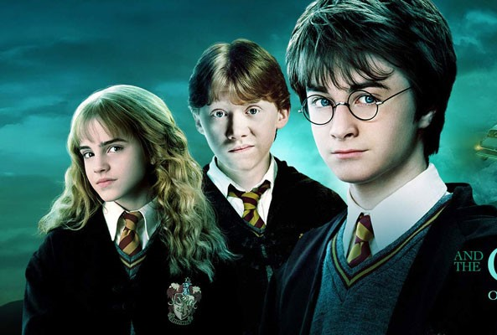
Harry POTTER CHAMBER OF SECRETs
Over Long Sequel Short of Magic

Slide 2
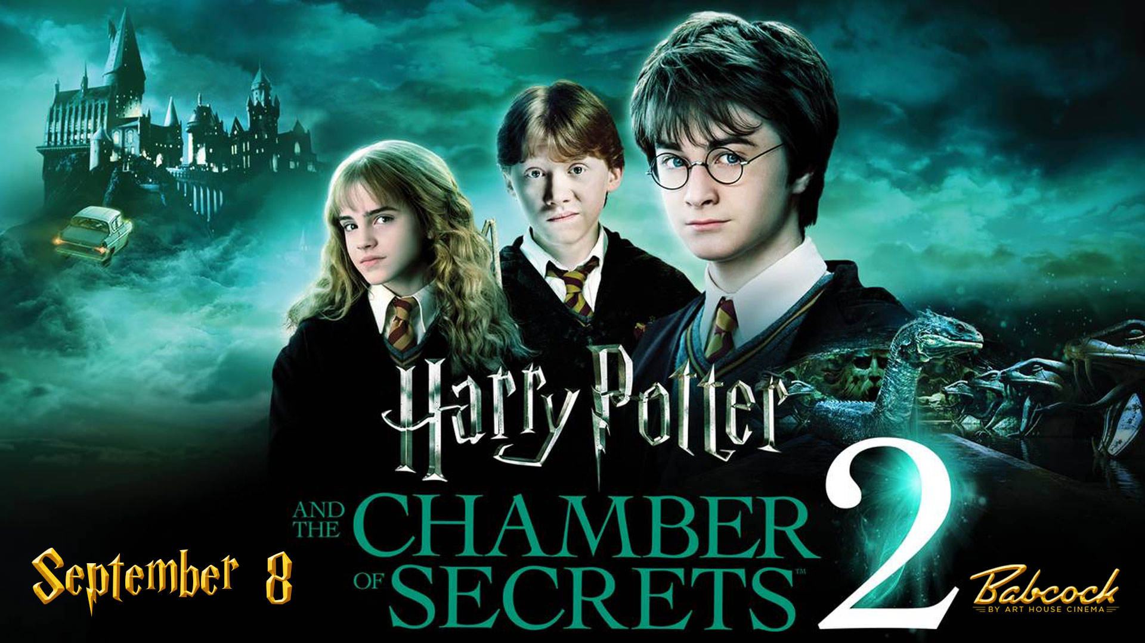
Movie in a GLIMPSE
Director: Chris Columbus
Writers : J. K. Rowling (novel) Steve Kloves (screenplay)
Genre(s): Adventure, Mystery, Fantasy, Family
Runtime: 161 min
Actors: Daniel Radcliffe. Rupert Grint. Emma Watson
Won 1 BAFTA Film Award: 13 wins & 46 nominations total

Slide 3
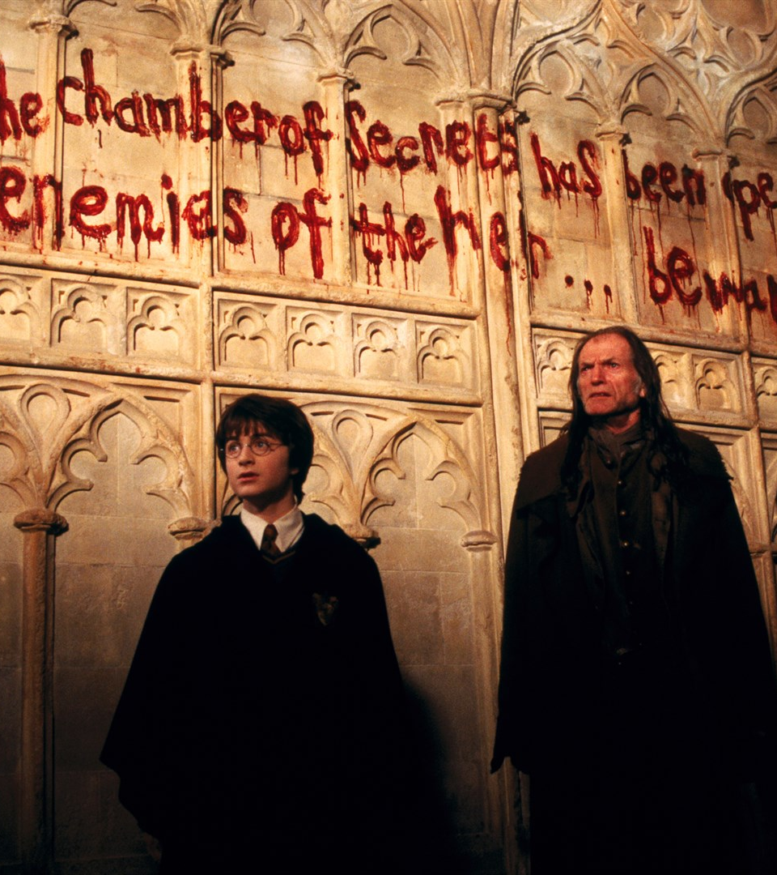
Synopsis
It's year two at Hogwarts, and Harry, Ron and Hermione are back learning, but their year doesn't go quietly.
Members of the school are turning up petrified and bloody writings are appearing on the walls, revealing to everyone, that someone has opened the Chamber of Secrets.
The attacks continue, bringing the possibility of the closure of Hogwarts. Harry and his friends are now forced to secretly uncover the truth about the chamber before the school closes or any lives are taken.

Slide 4
Roadmap
Research Question
Collect, process, and clean data
Thematic Analysis on Harry, Ron, Hermione Conversations
Script Analysis through R (Text mining, Social network analysis, Sentiment Analysis)
Movie Review Analysis (Text mining through R, Thematic Analysis) from 110 reviews Rotten Tomatoes and Metacritic
Insights/Recommendations

Slide 5
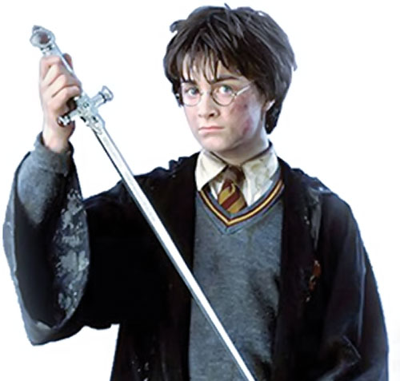
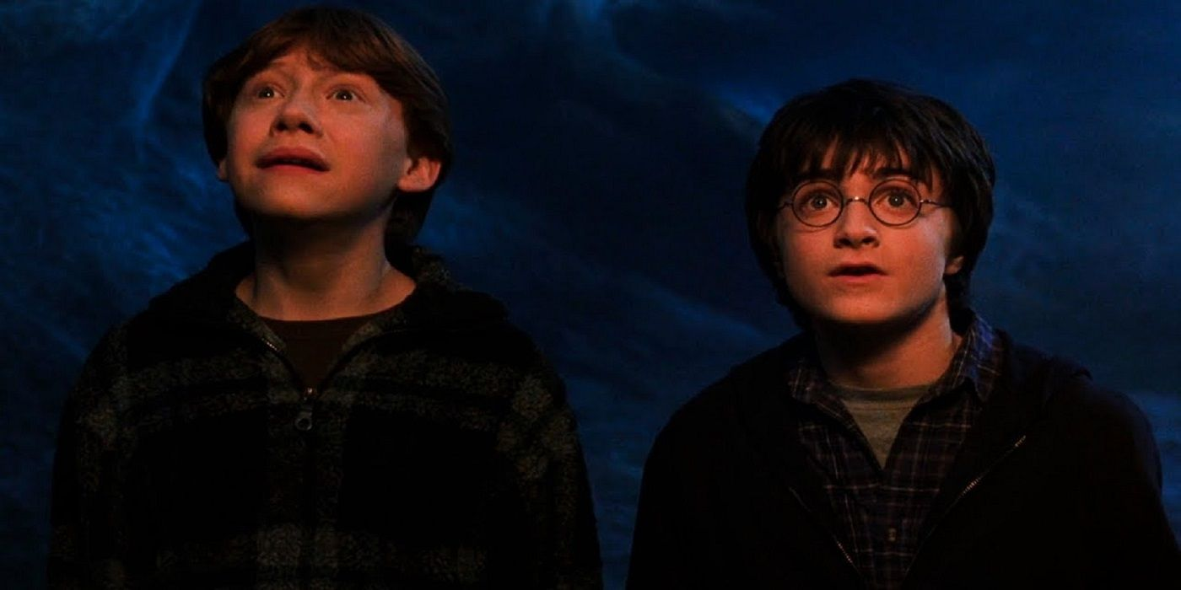

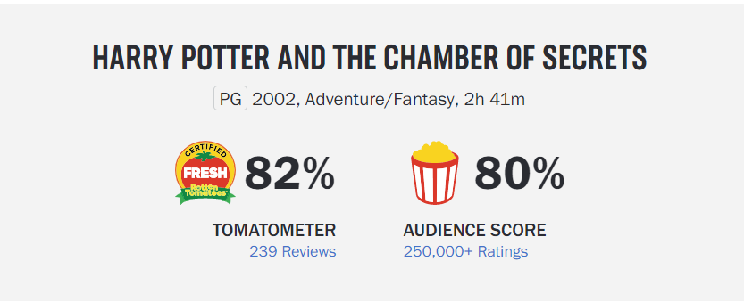
Research questions
Is Harry really the central character?
Is it time to let go of Ron?
Is the movie too dark for a younger audience?
How well did the audience receive this movie?

Slide 6
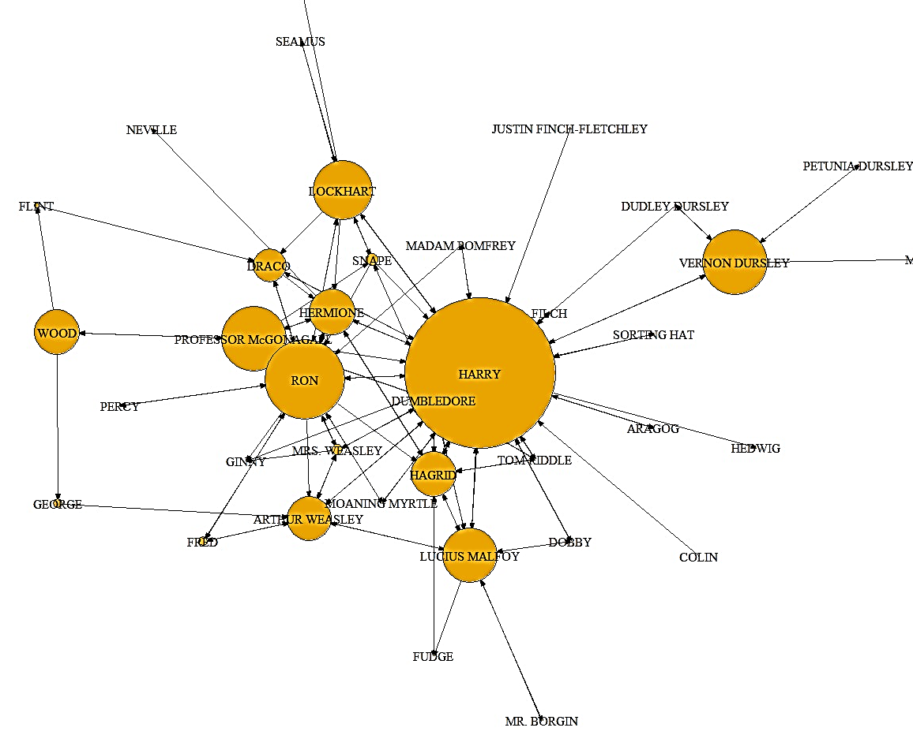
WHO IS THE CENTRAL CHARACTER?

Slide 7
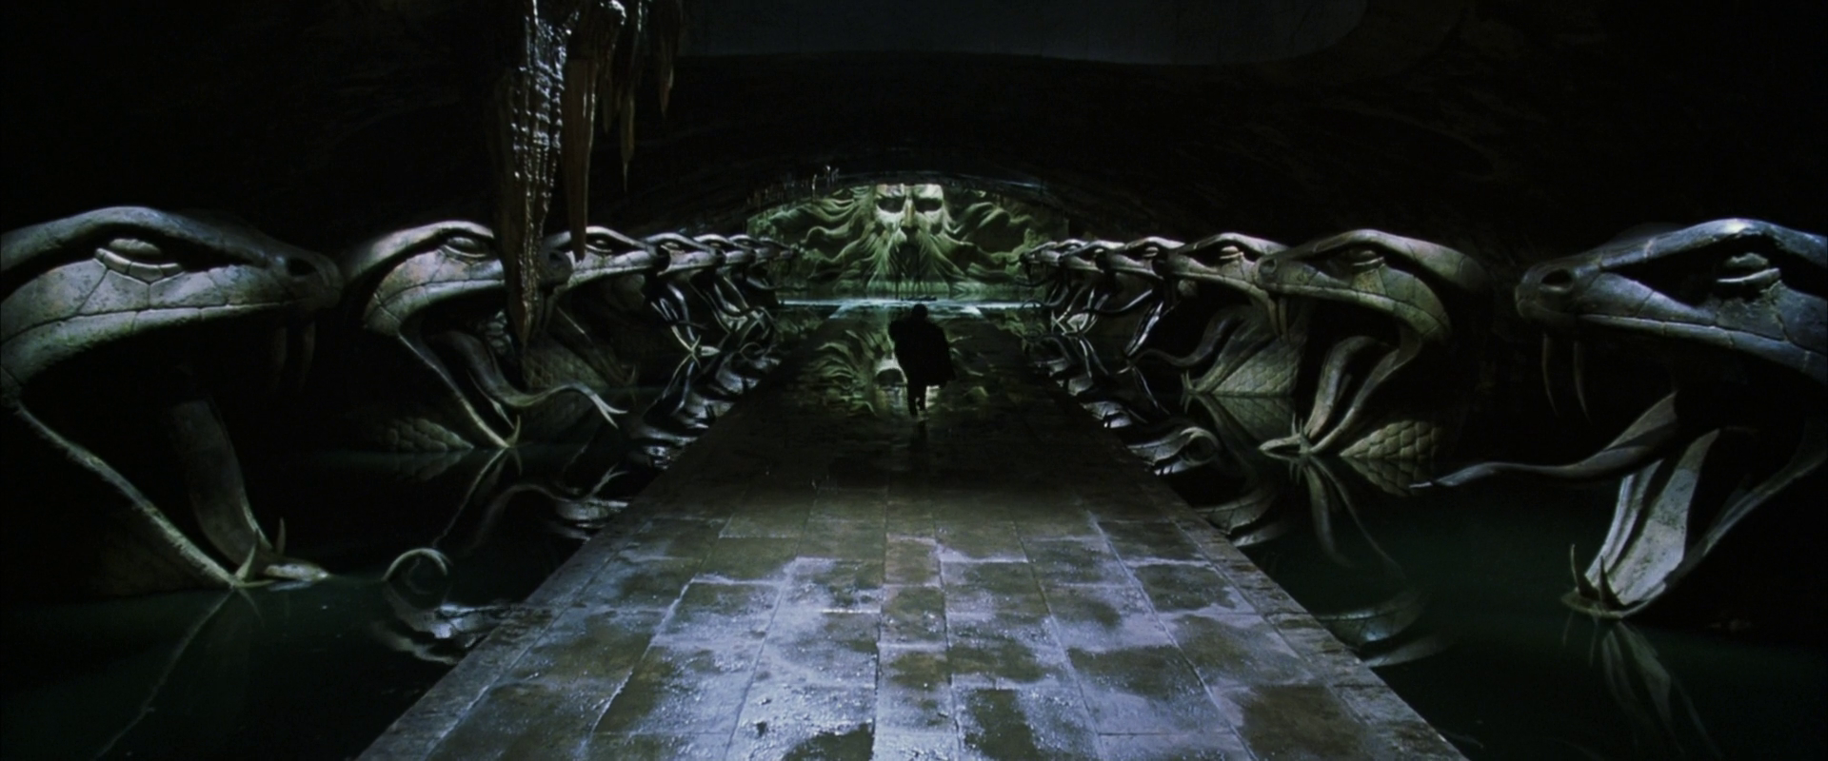
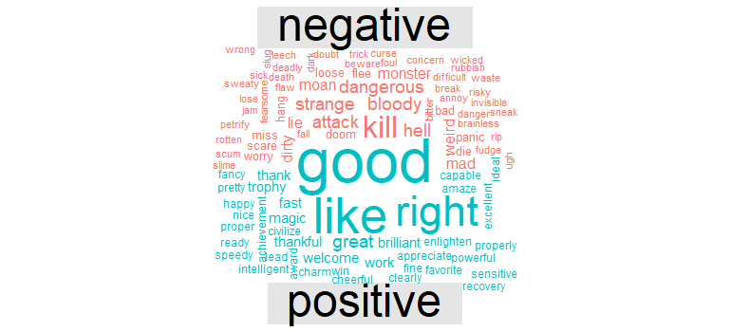
Word frequency overall movie

Slide 8
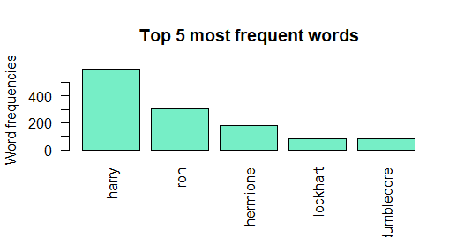
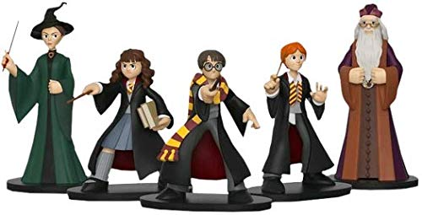
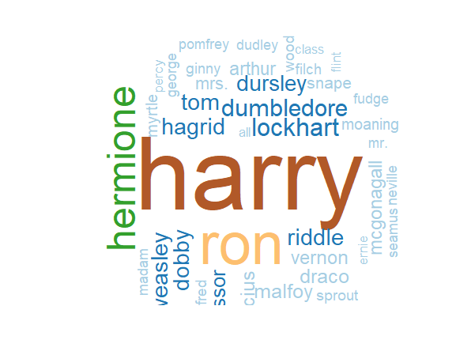
Top Characters

Slide 9
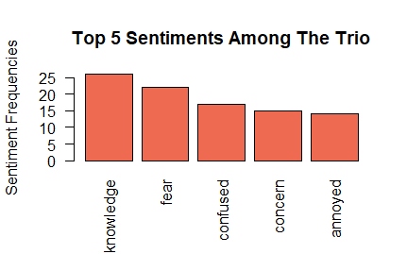
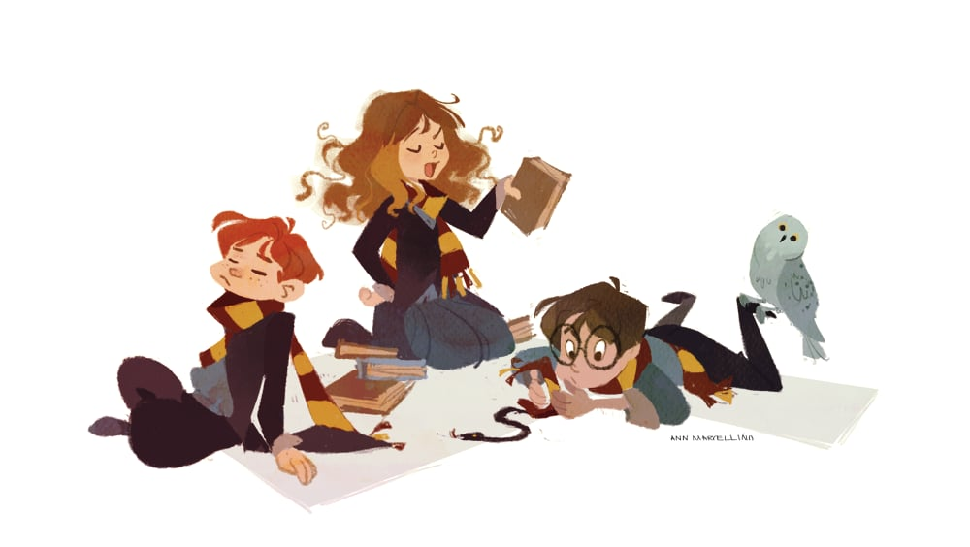
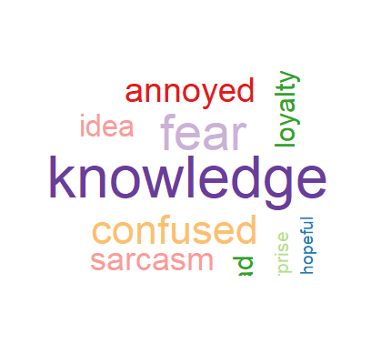
Harry, RON, Hermione Dynamics

Slide 10
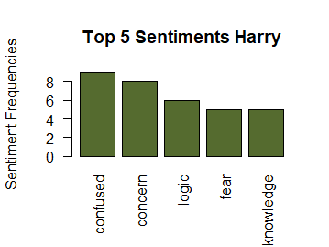
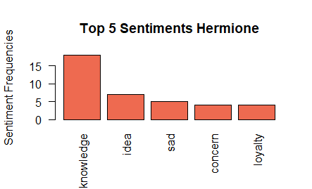
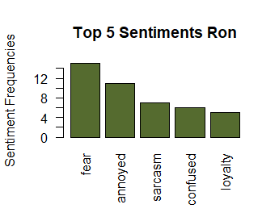
Comparing top Sentiments

Slide 11
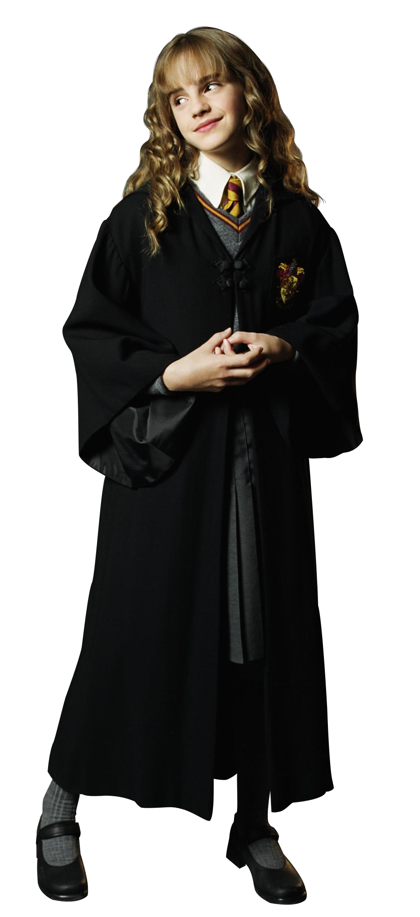
Is harry really the central character in the trio?

Slide 12
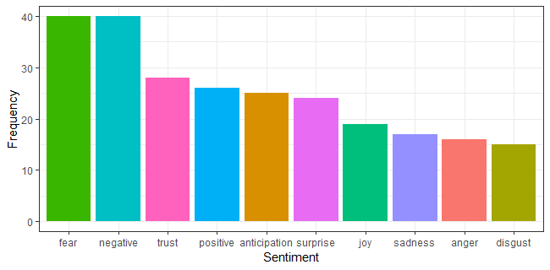
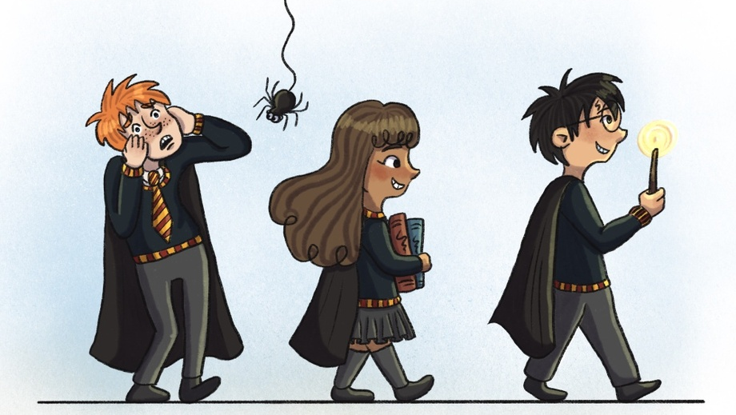
Character Analysis-Ron

Slide 13
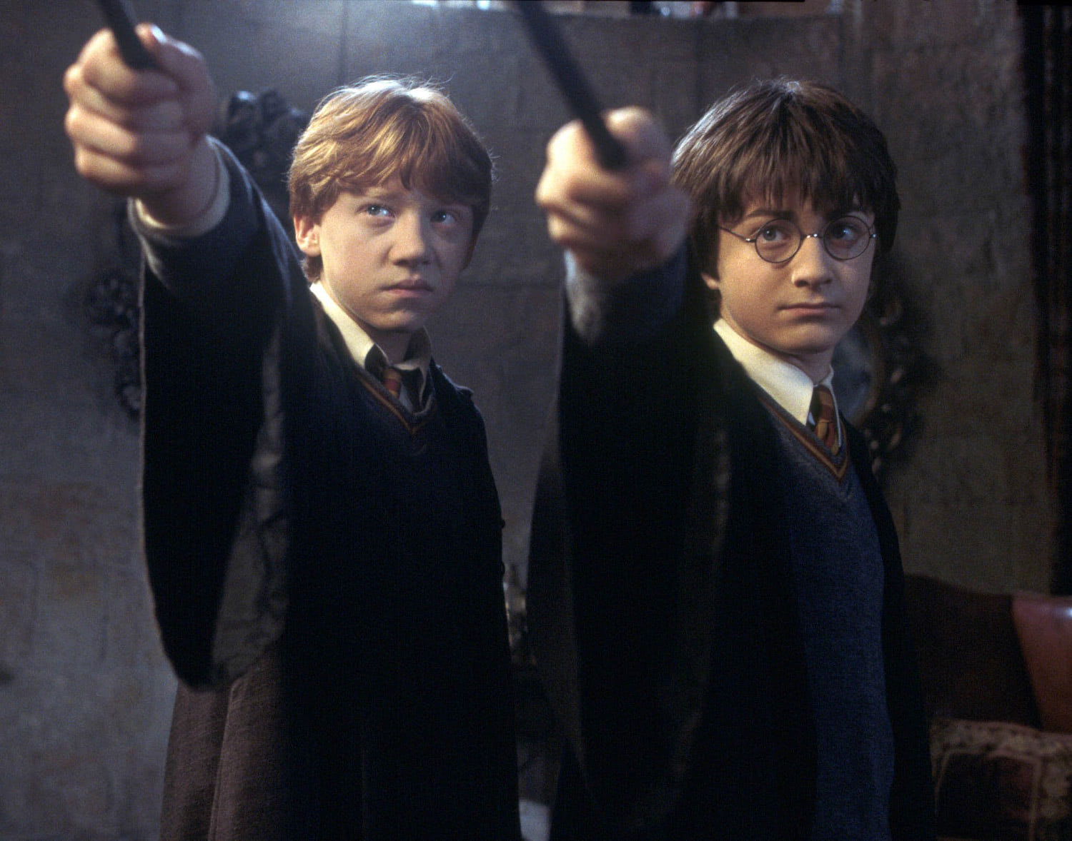

Slide 14
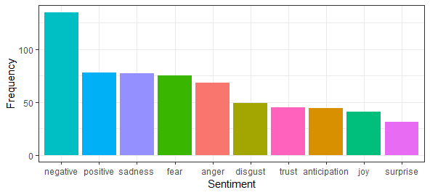
Sentiment analysis- Overall

Slide 15
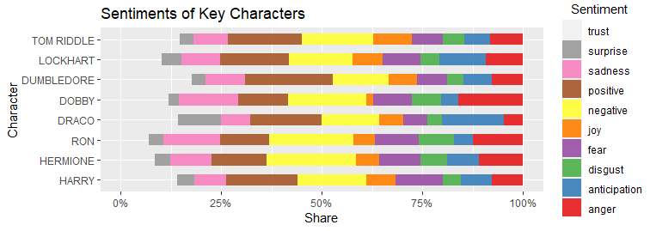
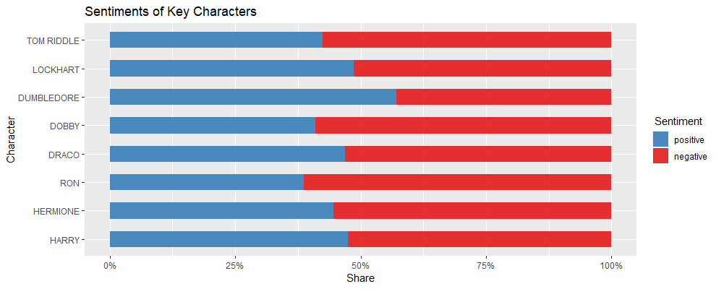
Sentiments of key characters

Slide 16
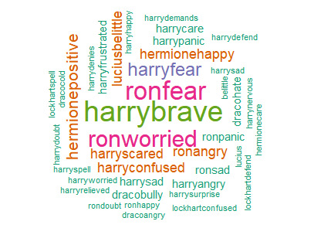

Slide 17
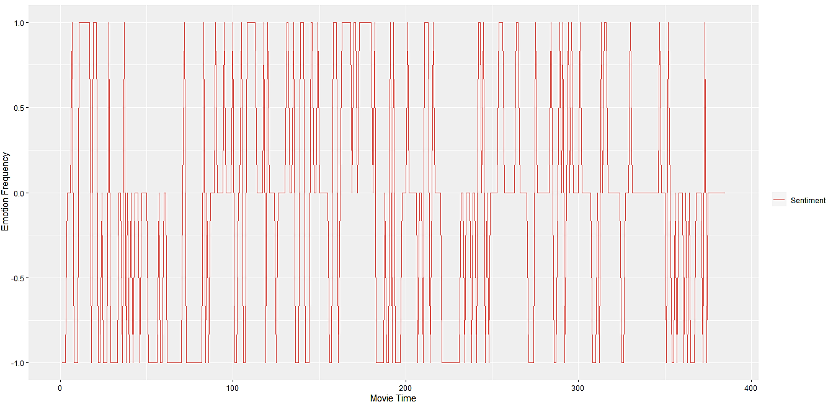





MOOD OF THE MOVIE

Slide 18
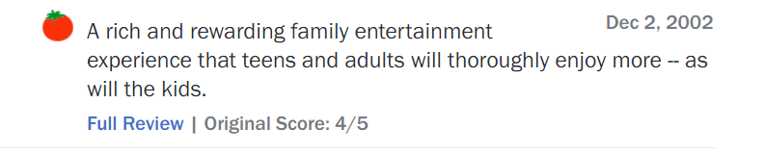
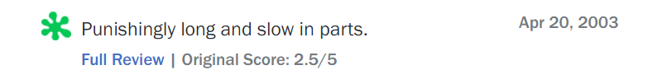
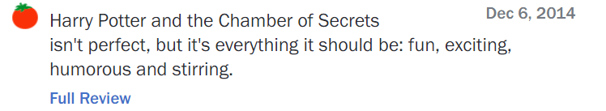
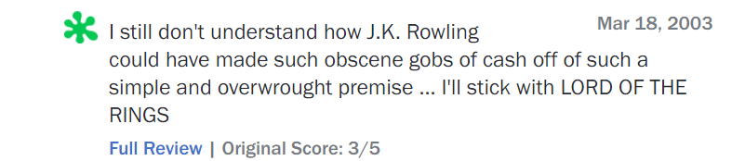
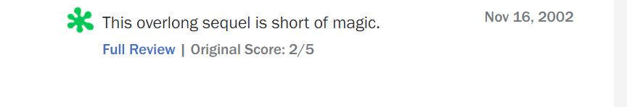
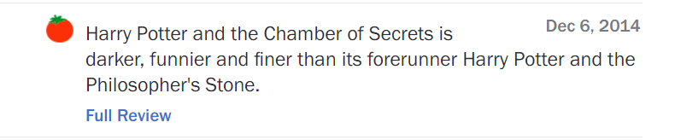
Movie reviews

Slide 19
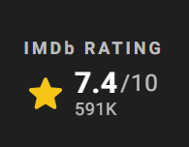
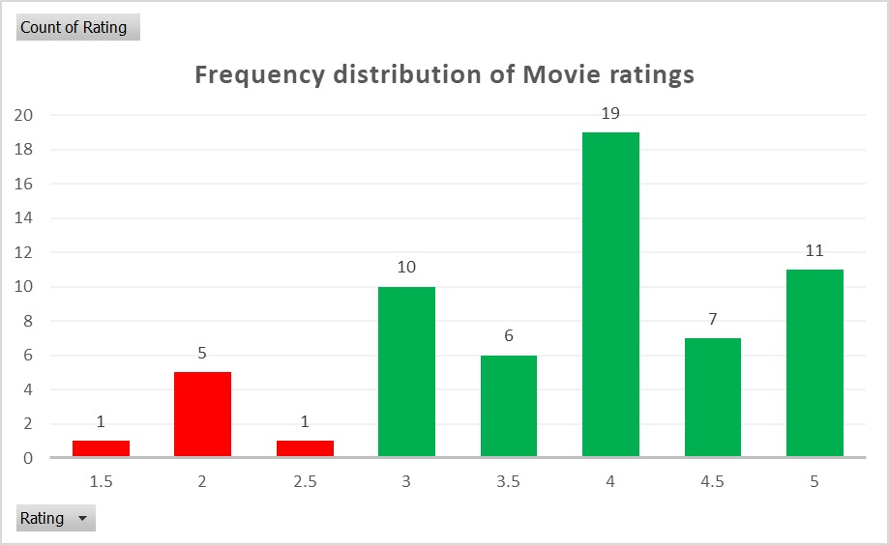

DEMOGRAPHIC RATING
2.5
4

Slide 20
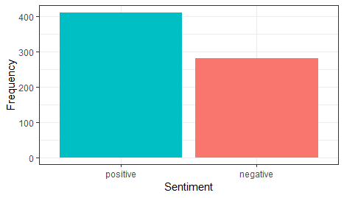
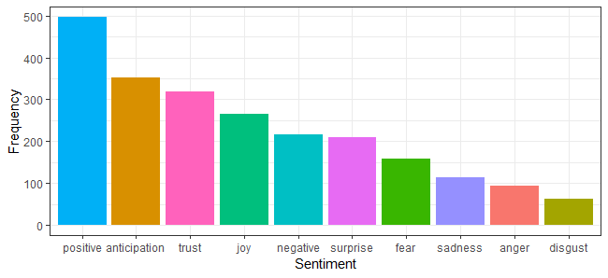
Movie Review Analysis

Slide 21
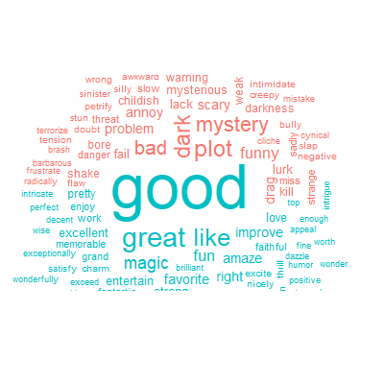
Movie review analysis

Slide 22
Insights
The movie's runtime is long and slows down in the middle, however this can be addressed in the subsequent parts. It has to be cut down in length and made more pleasant to watch for younger audience instead of dark.
Even though Harry is the central character, Hermione is as important as him. And we believe Ron has a lot of potential too.
As per the Sentiment Analysis the movie is predominantly dark and negative which might not be a great fit for children and can alter their emotion.

Slide 23
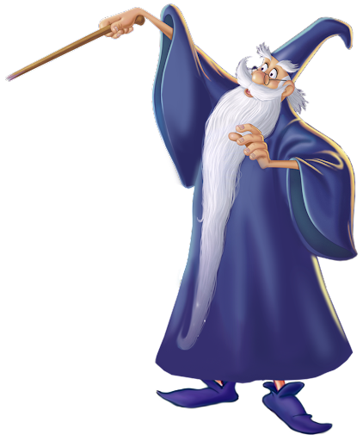
Thank you!

